Slide 1

PROPOSITIONAL LOGIC
Syntactic Approach

Slide 2

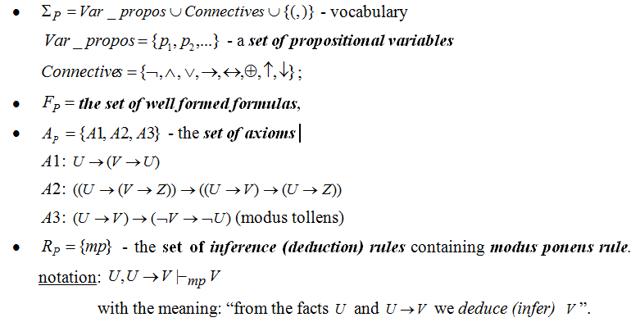
AXIOMATIC (FORMAL) SYSTEM:

Slide 3
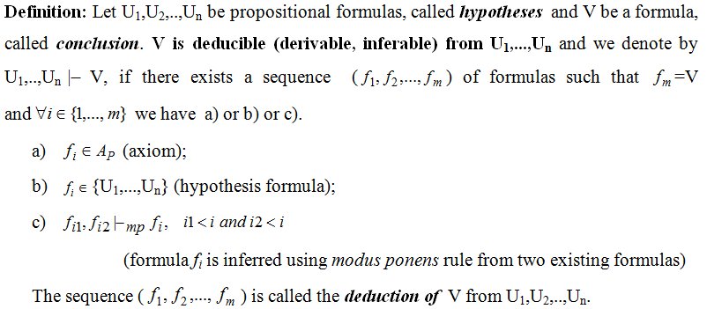
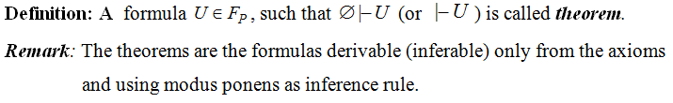
DEDUCTION

Slide 4
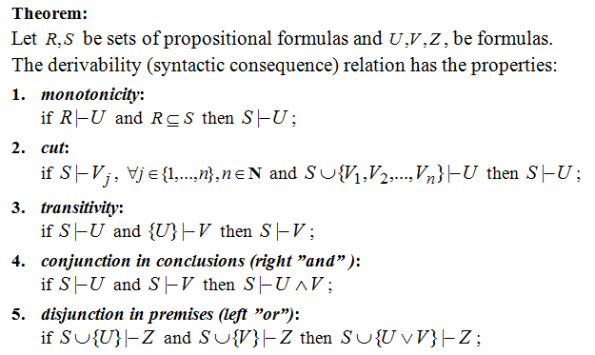
PROPERTIES OF DERIVABILITY RELATION

Slide 5
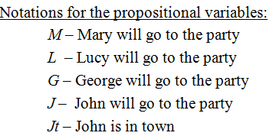
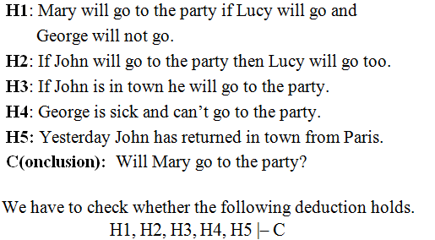
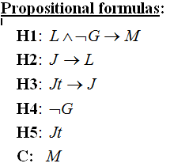
EXAMPLE 1 OF REASONING MODELING: PARTY

Slide 6
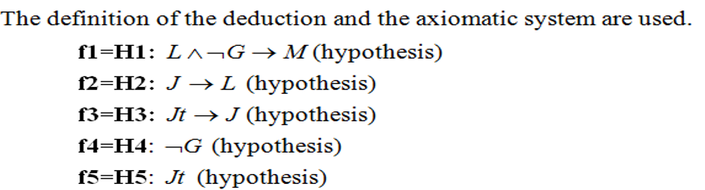




Slide 7
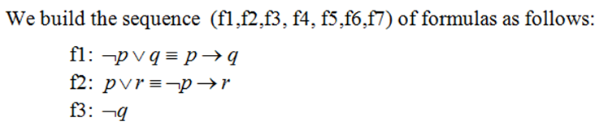

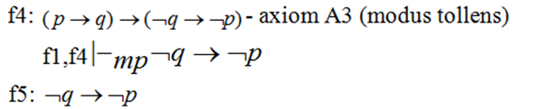
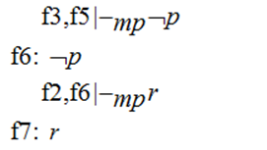
EXAMPLE 2

Slide 8
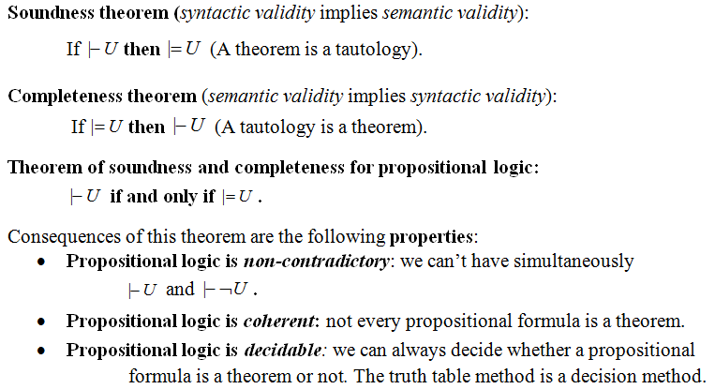
PROPERTIES OF PROPOSITIONAL LOGIC

Slide 9
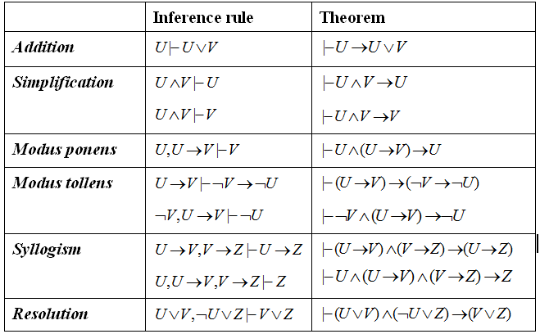
PROPOSITIONAL INFERENCE RULES

Slide 10
EXAMPLE 3 OF REASONING MODELING
Build a deduction of the conclusion (C) from the hypotheses H1, H2, H3, H4.
H1: If it is rainy Kate goes to the library or she goes shopping.
H2: Kate goes shopping only with her friend Carla.
H3: John goes to the library daily.
H4: It is rainy today, Carla is sick and she will not go shopping.
C (conclusion) Kate will meet John at the library today.

Slide 11
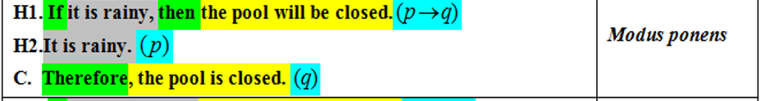
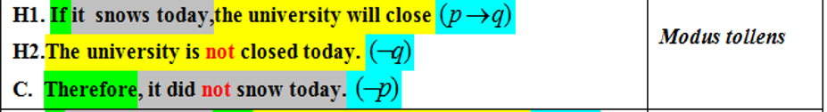
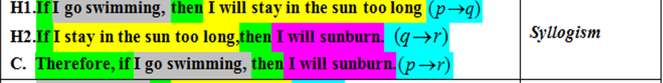
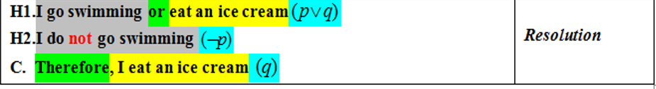
WHICH RULE OF INFERENCE IS USED IN EACH ARGUMENT BELOW?

Slide 12
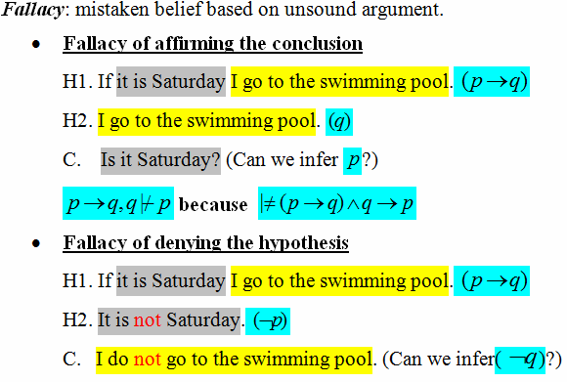
FALLACIES

Slide 13
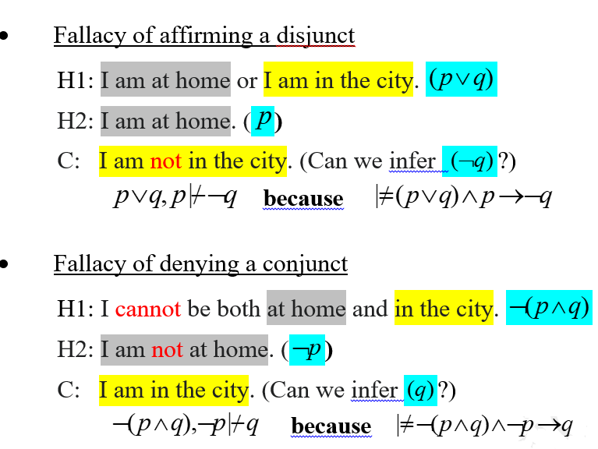
FALLACIES (contd.)

Slide 14

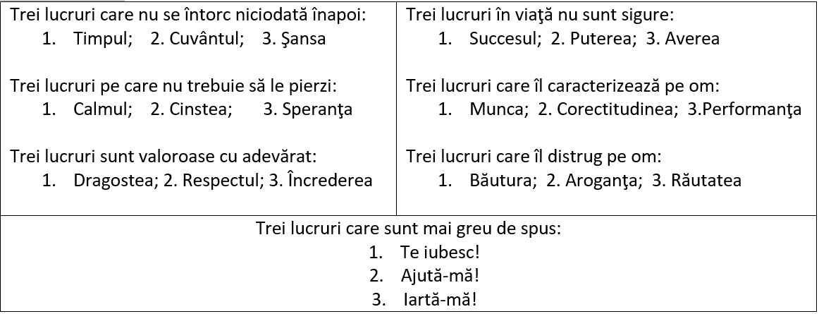
ÎNŢELEPCIUNE

Slide 15
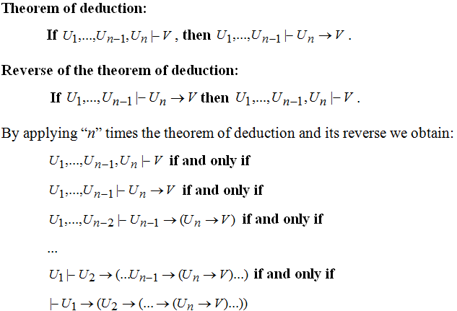
THEOREM OF DEDUCTION AND ITS REVERSE

Slide 16
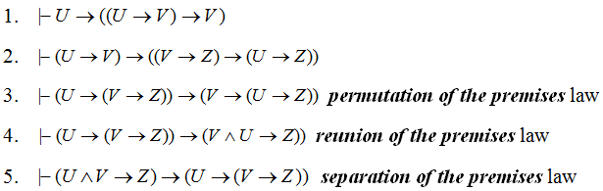
Theorem of deduction - consequences

Slide 17

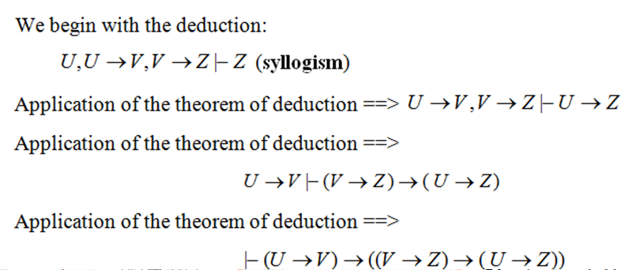
Proof

Slide 18
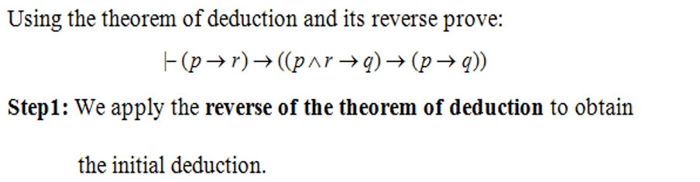
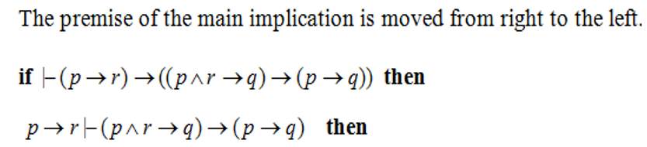

EXAMPLE 4 – THEOREM OF DEDUCTION

Slide 19
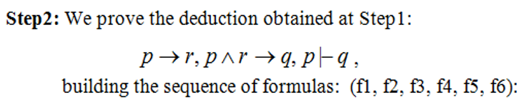





EXAMPLE 4 (CONTD.)

Slide 20
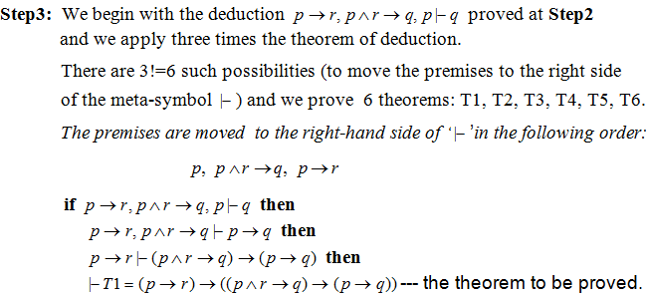
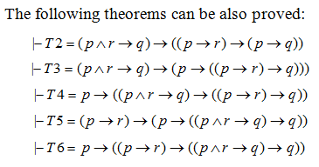
EXAMPLE 4 (CONTD.)

Slide 21
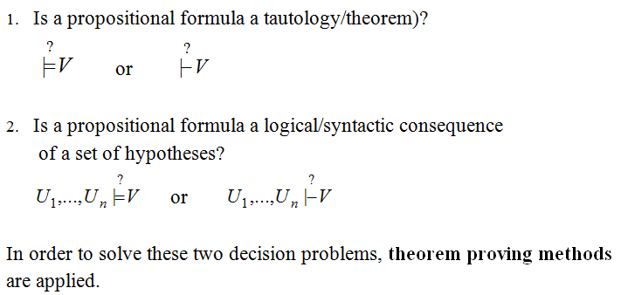
DECISION PROBLEMS IN PROPOSITIONAL LOGIC

Slide 22
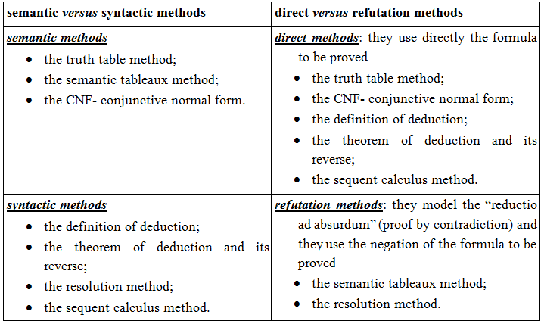
CLASSIFICATION OF PROOF METHODS

